Slide 1
Lecture 5: Numerical model selection and hypothesis testing

Slide 2
Model selection
Overfitting
Simple model,
A few parameters
OK
Complex model,
Many parameters

Slide 3
Model selection
Necessary tools for selection:
Comparison between models
Cross-validation
Hypothesis testing
Uncertainty estimation
Confidence intervals

Slide 4
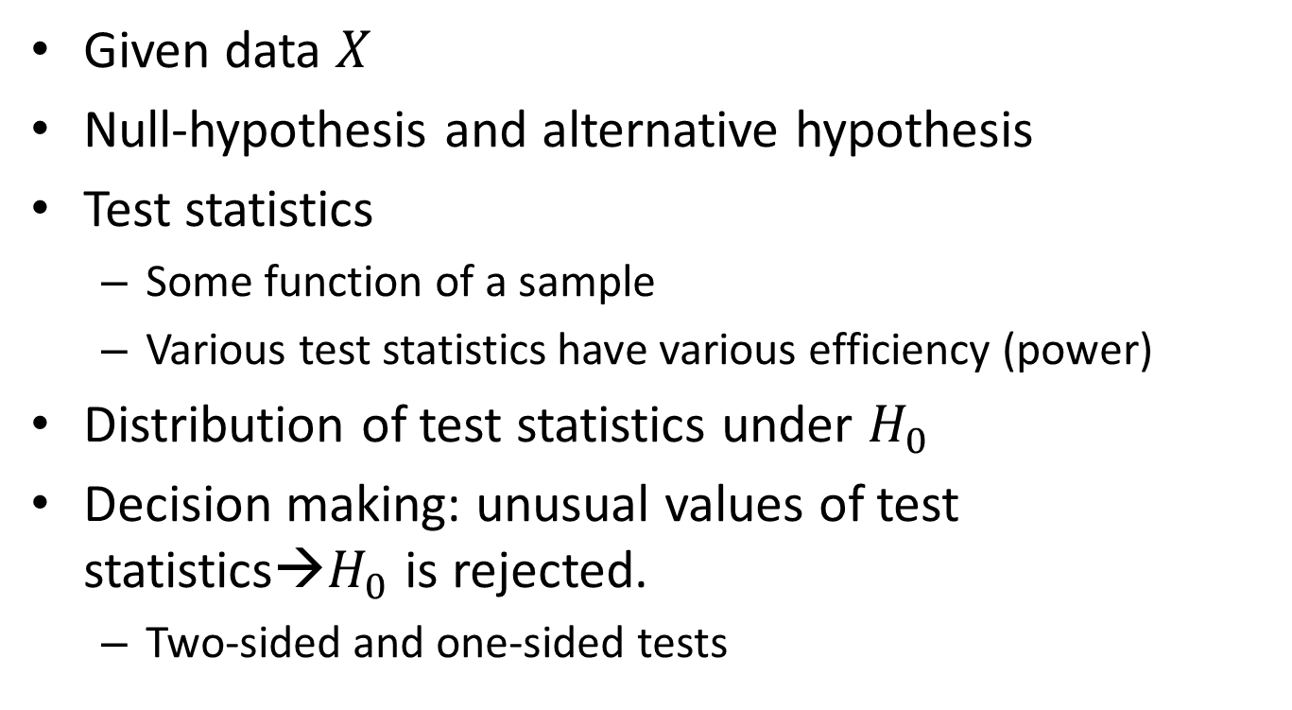
Hypothesis testing
Given data $X$
Null-hypothesis and alternative hypothesis
Test statistics
Some function of a sample
Various test statistics have various efficiency (power)
Distribution of test statistics under $H_{0}$
Decision making: unusual values of test statistics→$H_{0}$ is rejected.
Two-sided and one-sided tests

Slide 5
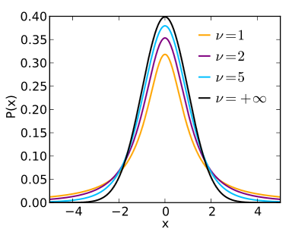
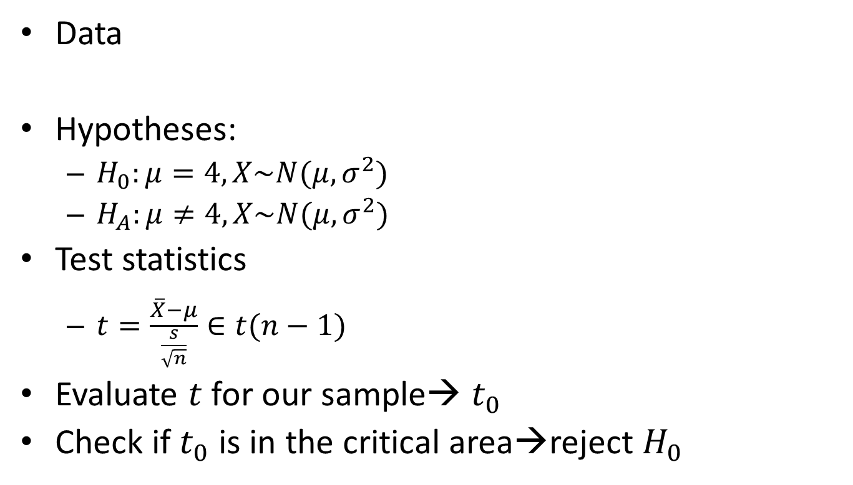
Hypothesis testing
Data
Hypotheses:
$H_{0}:μ=4, X\sim N(μ, σ^{2})$
$H_{A}:μ≠4, X\sim N(μ, σ^{2})$
Test statistics
$t=\frac{\overline{X}−μ}{\frac{s}{\sqrt{n}}}∈t(n−1)$
Evaluate $t$ for our sample→ $t_{0}$
Check if $t_{0}$ is in the critical area→reject $H_{0}$

Slide 6
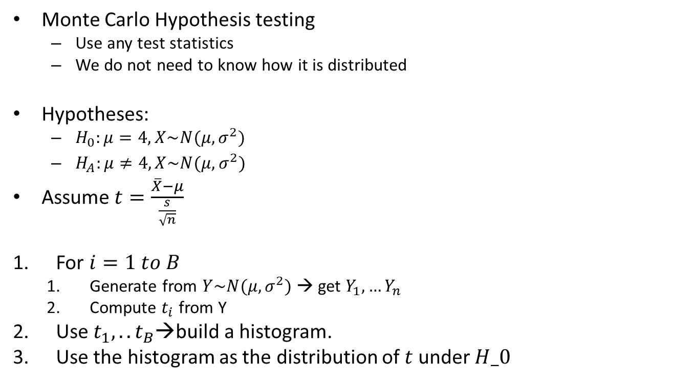
Hypothesis testing
Monte Carlo Hypothesis testing
Use any test statistics
We do not need to know how it is distributed
Hypotheses:
$H_{0}:μ=4, X\sim N(μ, σ^{2})$
$H_{A}:μ≠4, X\sim N(μ, σ^{2})$
Assume $t=\frac{\overline{X}−μ}{\frac{s}{\sqrt{n}}}$
For $i=1 to B$
Generate from $Y\sim N(μ, σ^{2})$ → get $Y_{1}, …Y_{n}$
Compute $t_{i}$ from Y
Use $t_{1}, ..t_{B}$→build a histogram.
Use the histogram as the distribution of $t$under $H_0$

Slide 7
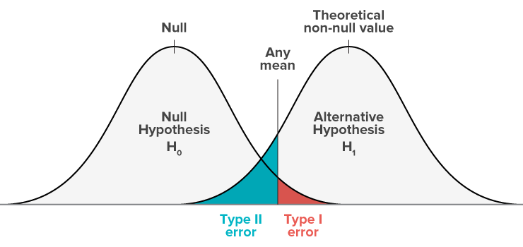


Hypothesis testing
How good is the test statistics? Power!
$Power=1−Type II error$
How to compute Power?
Generate data samples that satisfy $H_{a}$
Compute percent of correct rejections
Source: grasshopper.com

Slide 8
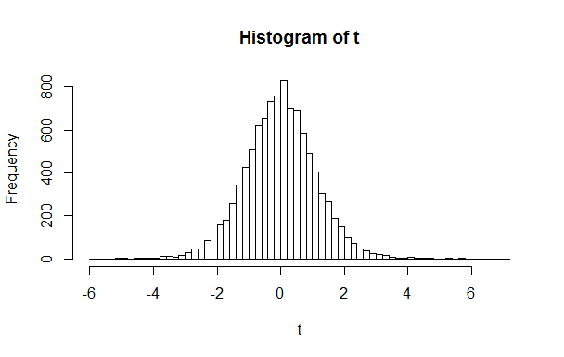
Hypothesis testing
s=var(X)
B=10000
n=10
t=numeric(B)
for (i in 1:B) {
Y=rnorm(10,4,s)
t[i]=(mean(Y)-4)/(sd(Y)/sqrt(10))
}
hist(t,50)
What to do if we don’t know the distribution of the data? → permutation tests or bootstrap tests!

Slide 9
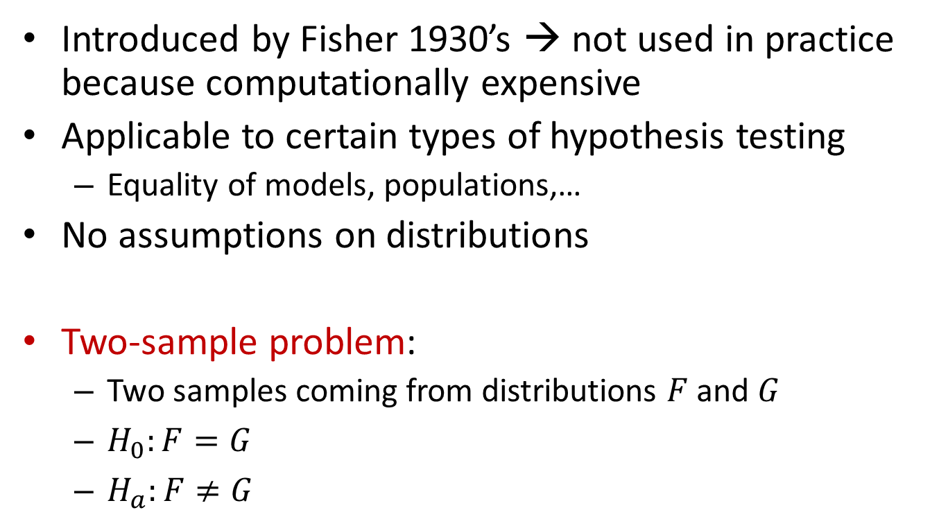
Permutation tests
Introduced by Fisher 1930’s → not used in practice because computationally expensive
Applicable to certain types of hypothesis testing
Equality of models, populations,…
No assumptions on distributions
Two-sample problem:
Two samples coming from distributions $F$and $G$
$H_{0}:F=G$
$H_{a}:F≠G$

Slide 10
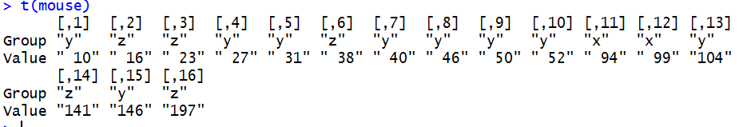
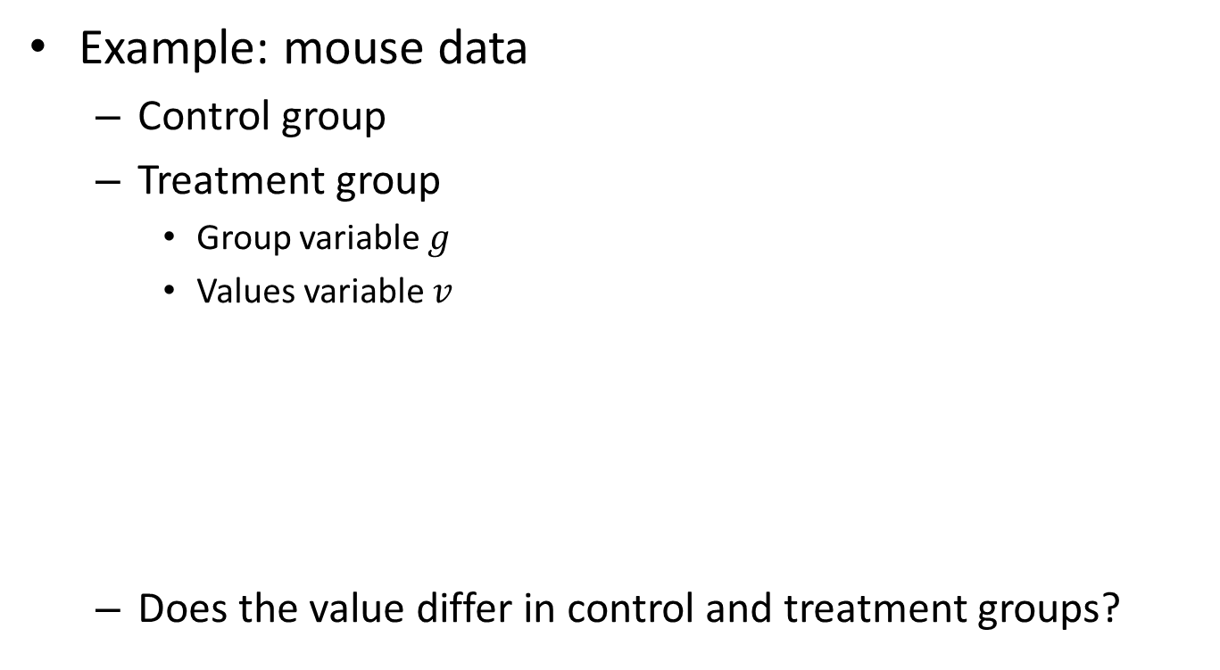
Permutation tests
Example: mouse data
Control group
Treatment group
Group variable $g$
Values variable $v$
Does the value differ in control and treatment groups?

Slide 11
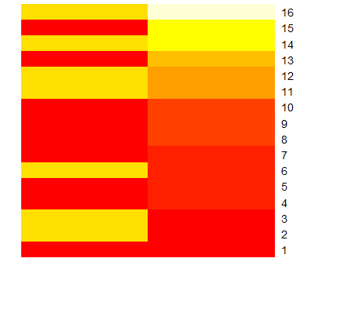
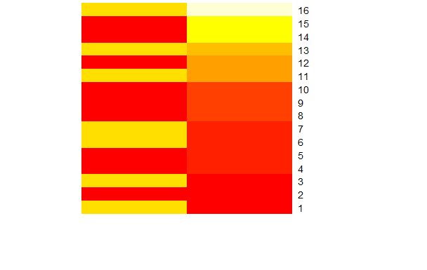
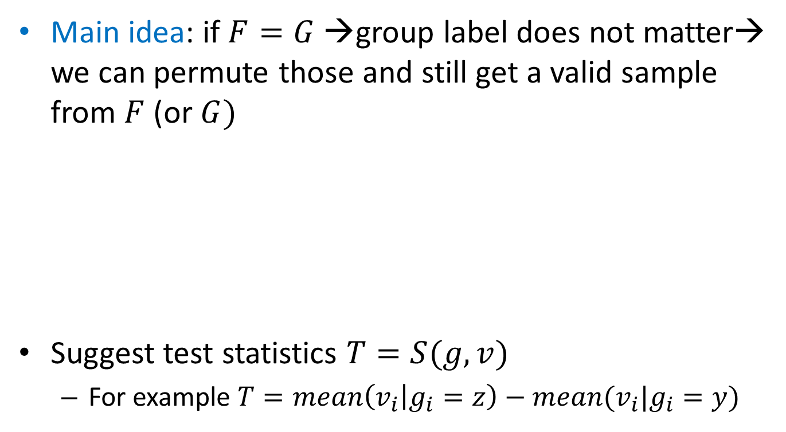
Permutation tests
Main idea: if $F=G$ →group label does not matter→ we can permute those and still get a valid sample from $F$ (or $G)$
Suggest test statistics $T=S(g,v)$
For example $T=mean\left(v_{i} | g_{i}=z\right)−mean(v_{i}|g_{i}=y)$
Group Value
Group Value
Before permutation
After permutation

Slide 12
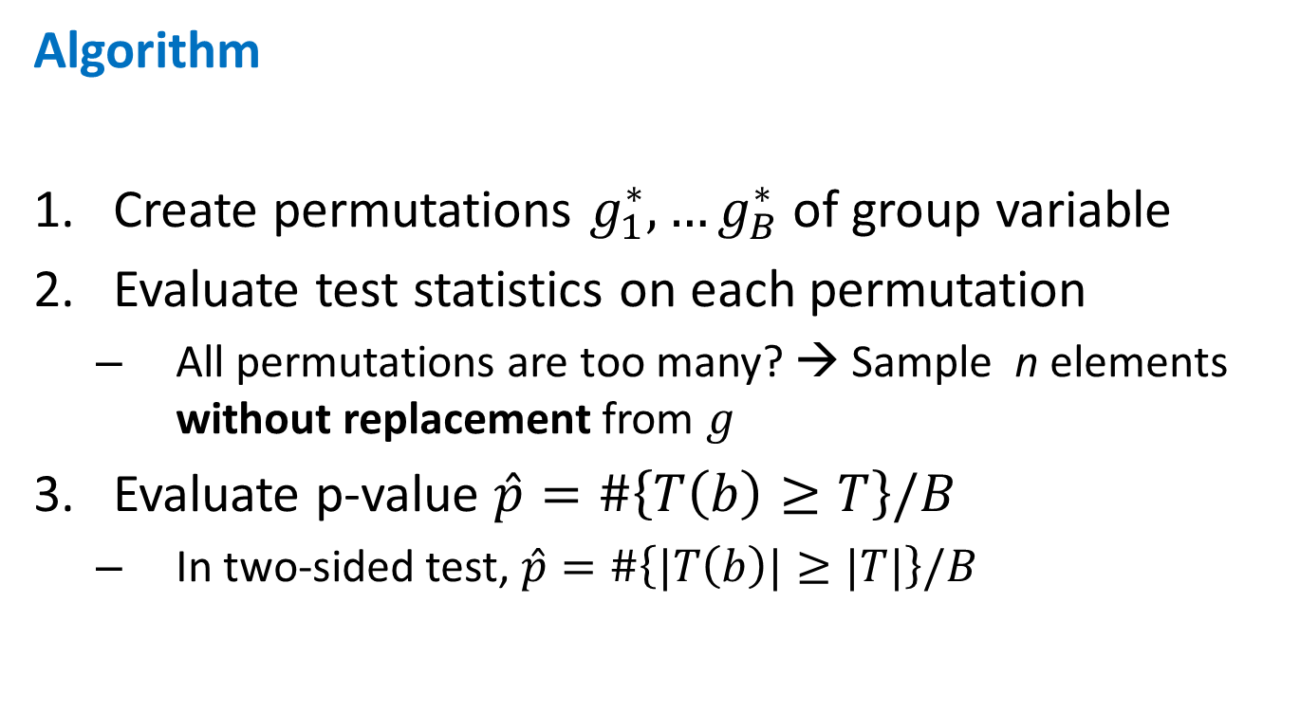
Permutation tests
Algorithm
Create permutations $g_{1}^{∗}, …g_{B}^{∗}$ of group variable
Evaluate test statistics on each permutation
All permutations are too many? → Sample n elements without replacement from $g$
Evaluate p-value $\hat{p}=\#\left\{T\left(b\right)≥T\right\}/B$
In two-sided test, $\hat{p}=\#\left\{|T\left(b\right)|≥|T|\right\}/B$

Slide 13
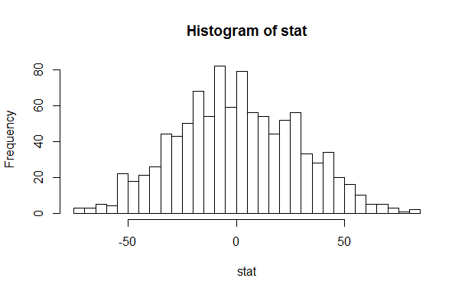
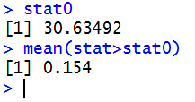
Permutation tests
Code
B=1000
stat=numeric(B)
n=dim(mouse)[1]
for(b in 1:B){
Gb=sample(mouse$Group, n)
stat[b]=mean(mouse$Value[Gb=='z'])-mean( (mouse$Value[Gb=='y']))
}
hist(stat,50)
stat0=mean(mouse$Value[mouse$Group=='z'])-mean (mouse$Value[mouse$Group=='y'])
mean(stat>stat0)
Do we reject null hypothesis?

Slide 14
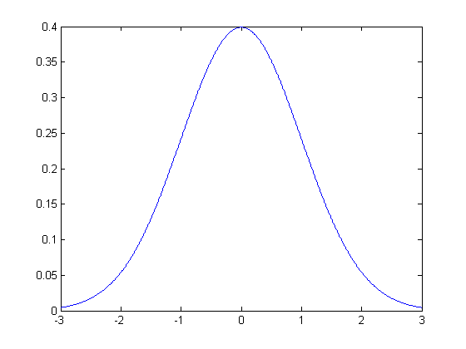
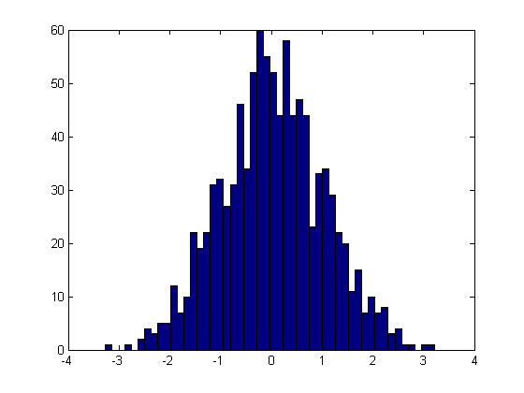

The bootstrap: general principle
We want to determine uncertainty of $T(D)$
Generate many different $D_{i}$ from their distribution
Use histogram of $T(D_{i})$ to determine confidence limits→ unfortunately can not be done (distr of D is often unknown)
Instead: Generate many different $D_{i}^{∗}$ from the empirical distribution (histogram)

Slide 15
Nonparametric bootstrap
Observed data
Resampled data
22
60
41
Sampling with replacement
88
34
58
67
88
79
90
88
79
62
39
41
73
41
90
58
44
22
34
44
70
60
70
60
85
85

Slide 16
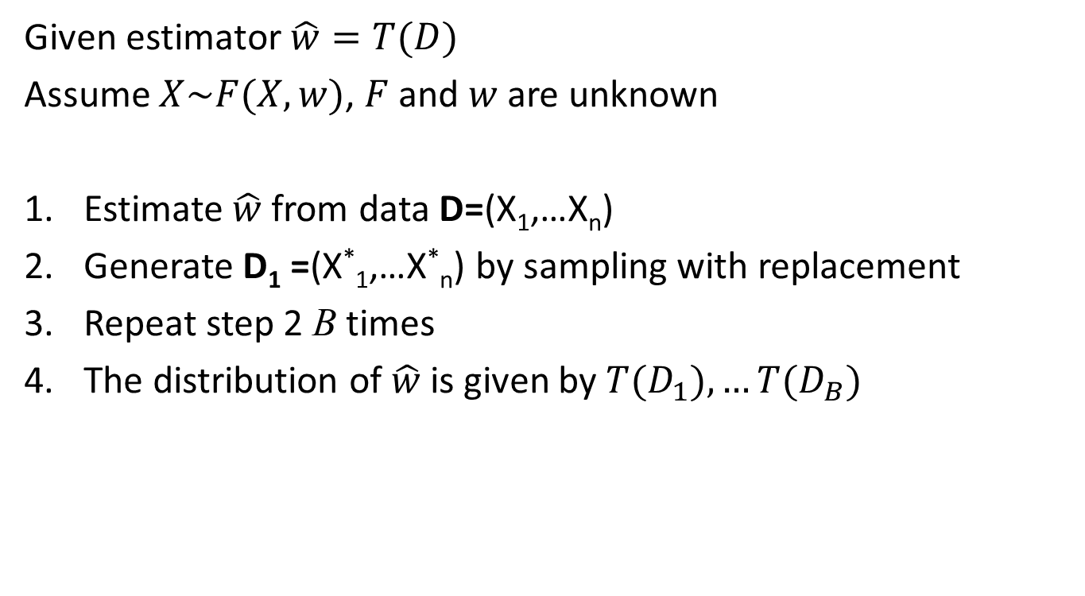
Nonparametric bootstrap
Given estimator$\hat{w}=T(D)$
Assume $X\sim F(X, w)$, $F$ and $w$ are unknown
Estimate $\hat{w}$ from data D=(X₁,…X_{n})
Generate D₁ =(X*₁,…X*_{n}) by sampling with replacement
Repeat step 2 B times
The distribution of $\hat{w}$is given by $T(D_{1}),…T(D_{B})$
Nonparametric bootstrap can be applied to any deterministic estimator, distribution-free

Slide 17
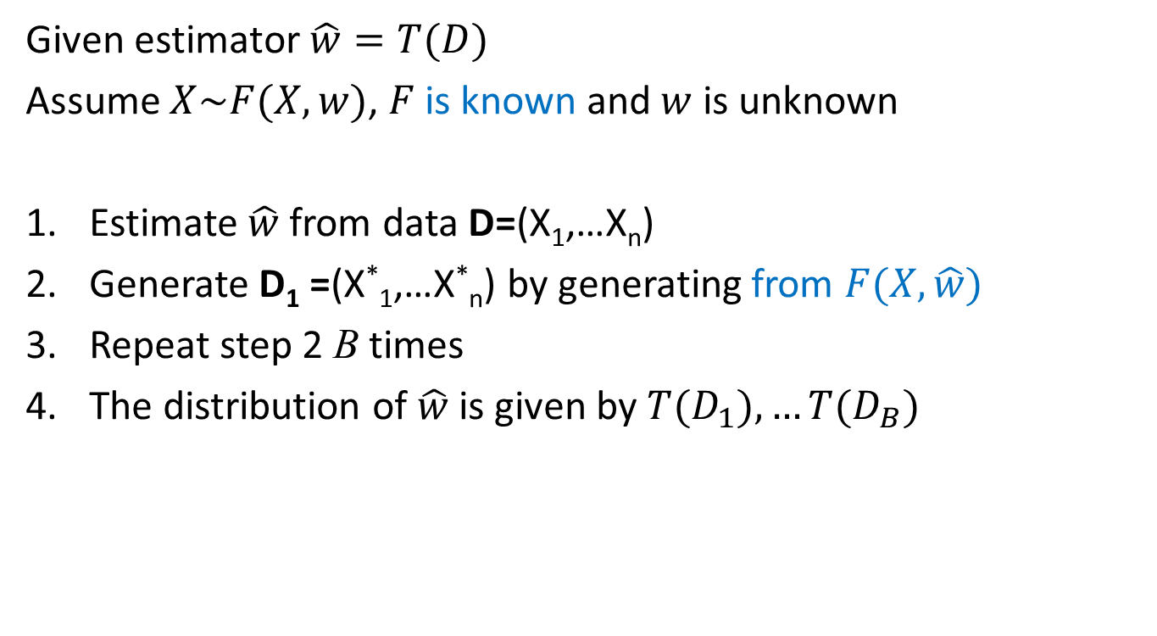
Parametric bootstrap
Given estimator$\hat{w}=T(D)$
Assume $X\sim F(X, w)$, $F$ is known and $w$ is unknown
Estimate $\hat{w}$ from data D=(X₁,…X_{n})
Generate D₁ =(X*₁,…X*_{n}) by generating from $F(X, \hat{w})$
Repeat step 2 B times
The distribution of $\hat{w}$ is given by $T(D_{1}),…T(D_{B})$
Parametric bootstrap is more precise if the distribution form is correct

Slide 18

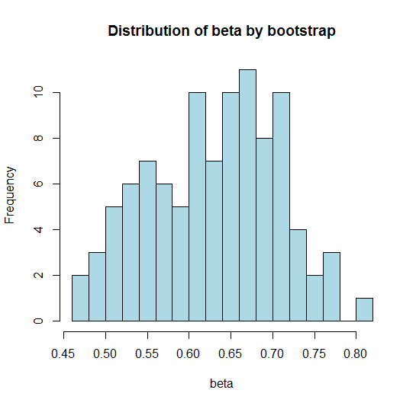
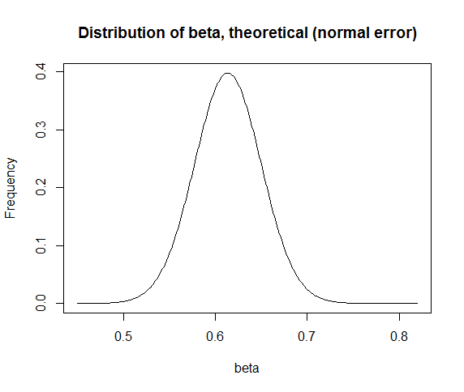
Example
Distribution of regression coefficient
stat1<-function(data,n){
data1=data[n,];
res<-lm(Price~Area, data1)
ret=res$coefficients[2]
return(ret)
}
res=boot(data,stat1,R=100)
hist(res$t,20)

Slide 19
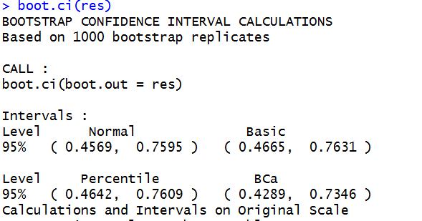
Bootstrap confidence intervals
obtained from the distribution given by the bootstrap
R: boot.ci() for one variable, envelope() for many variables
boot.ci(res)

Slide 20
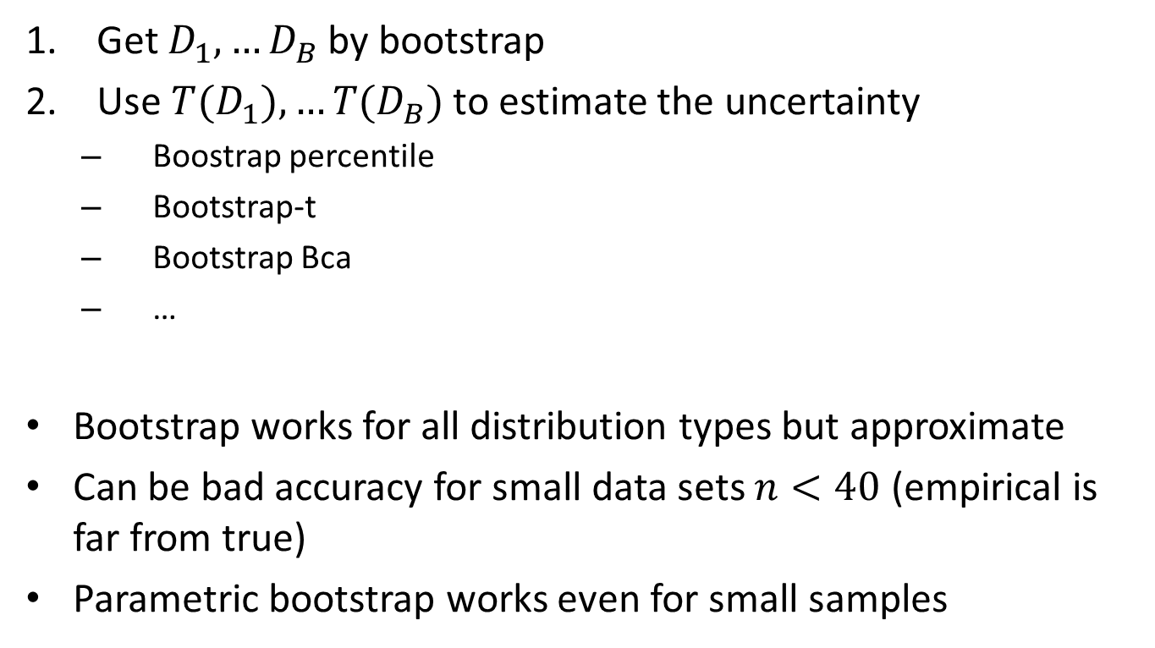
Uncertainty estimation
Get $D_{1}^{}, …D_{B}^{}$ by bootstrap
Use ${T(D}_{1}^{}), …{T(D}_{B}^{})$ to estimate the uncertainty
Boostrap percentile
Bootstrap-t
Bootstrap Bca
…
Bootstrap works for all distribution types but approximate
Can be bad accuracy for small data sets $n<40$ (empirical is far from true)
Parametric bootstrap works even for small samples

Slide 21
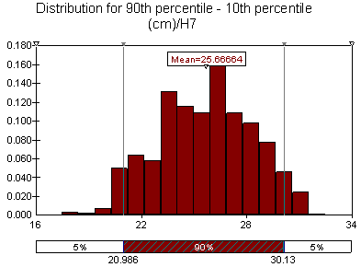
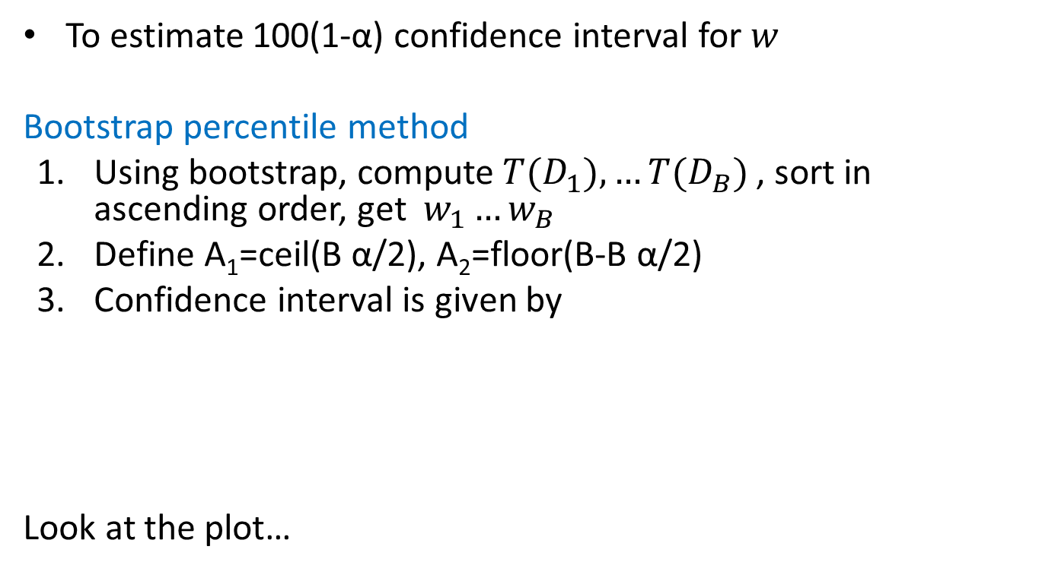
Bootstrap confidence intervals
To estimate 100(1-α) confidence interval for $w$
Bootstrap percentile method
Using bootstrap, compute ${T(D}_{1}^{}), …{T(D}_{B}^{})$ , sort in ascending order, get $w_{1}…w_{B}$
Define A₁=ceil(B α/2), A₂=floor(B-B α/2)
Confidence interval is given by
Look at the plot…

Slide 22
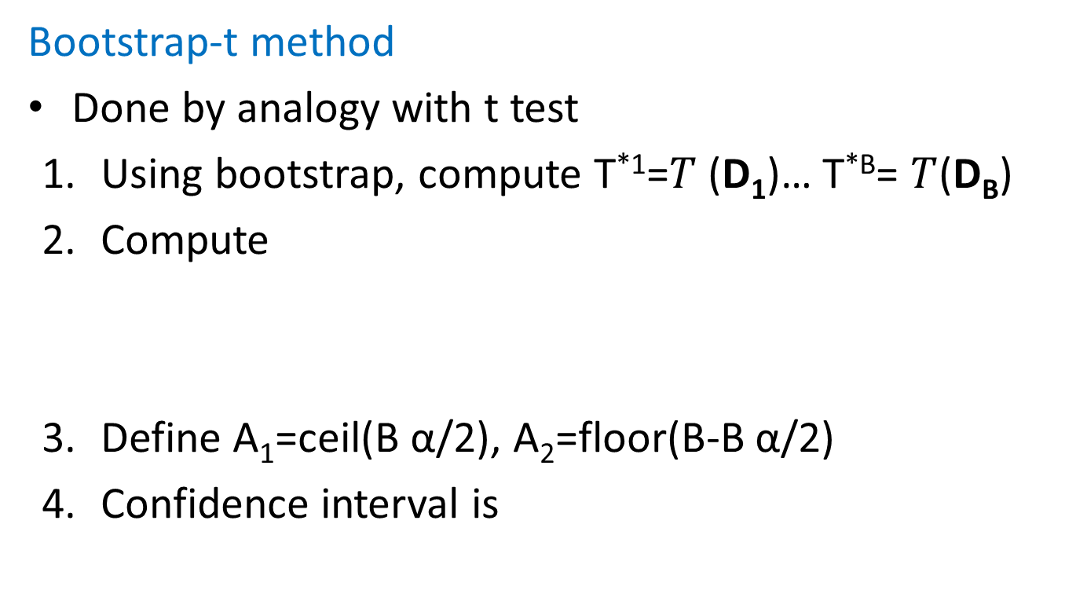
Bootstrap confidence intervals
Bootstrap-t method
Done by analogy with t test
Using bootstrap, compute T^{*1}=$T$(D₁)… T^{*B}= $T$(D_{B})
Compute
Define A₁=ceil(B α/2), A₂=floor(B-B α/2)
Confidence interval is

Slide 23
Bootstrap confidence intervals
Comments
se is square root of estimated variance
Estimation se(T^{*j}) typically requires second-level bootstrap -> bootstrap-t is computationally intensive
Bootstrap-t is more accurate than percentile (coverage error)
Bootstrap BC_{a} is a more advanced bootstrap CI method

Slide 24
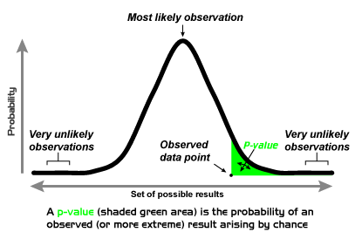
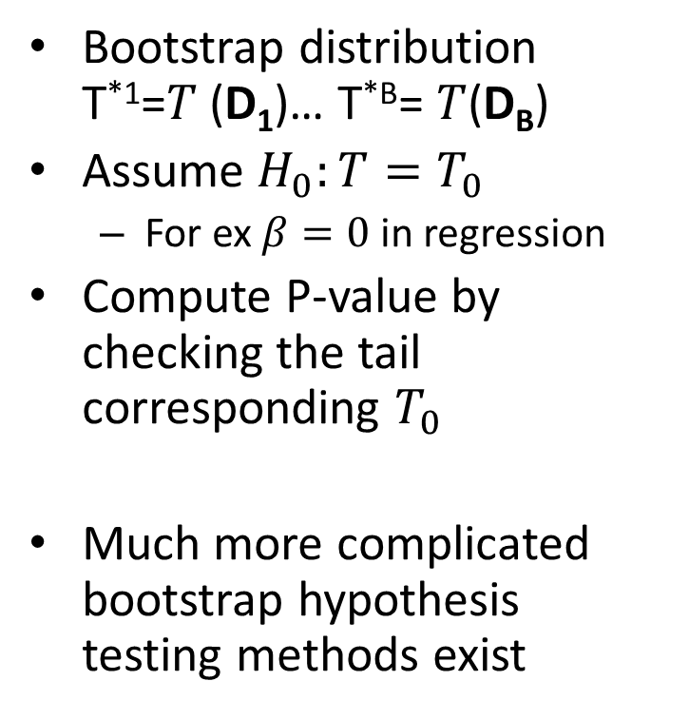
Bootstrap hypothesis testing
Bootstrap distribution T^{*1}=$T$(D₁)… T^{*B}= $T$(D_{B})
Assume $H_{0}:T=T_{0}$
For ex $β=0$ in regression
Compute P-value by checking the tail corresponding $T_{0}$
Much more complicated bootstrap hypothesis testing methods exist
Source: Wikipedia

Slide 25
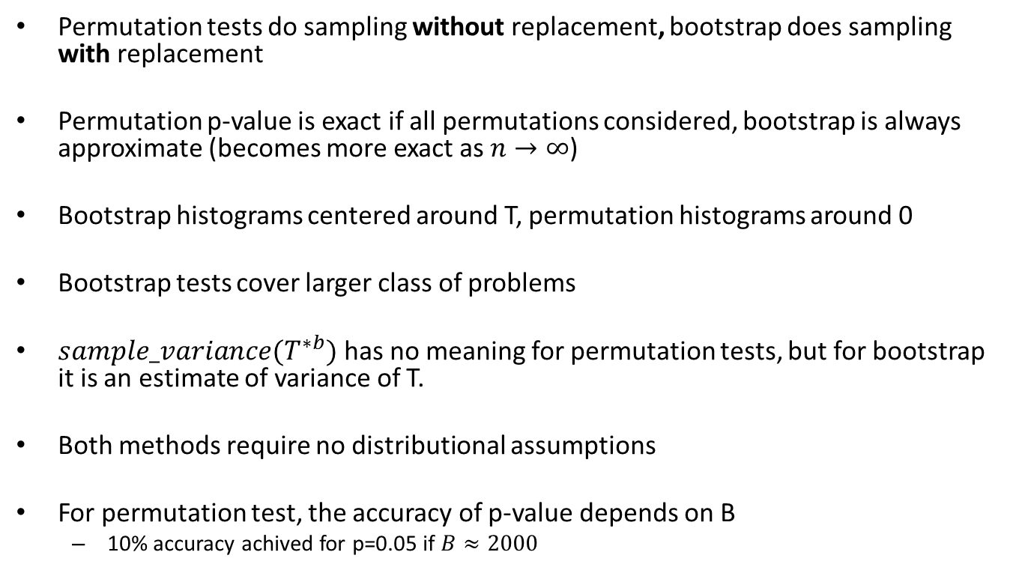
Bootstrap tests vs permutation tests
Permutation tests do sampling without replacement, bootstrap does sampling with replacement
Permutation p-value is exact if all permutations considered, bootstrap is always approximate (becomes more exact as $n→∞$)
Bootstrap histograms centered around T, permutation histograms around 0
Bootstrap tests cover larger class of problems
$sample_variance(T^{∗b})$ has no meaning for permutation tests, but for bootstrap it is an estimate of variance of T.
Both methods require no distributional assumptions
For permutation test, the accuracy of p-value depends on B
10% accuracy achived for p=0.05 if $B≈2000$

Slide 26
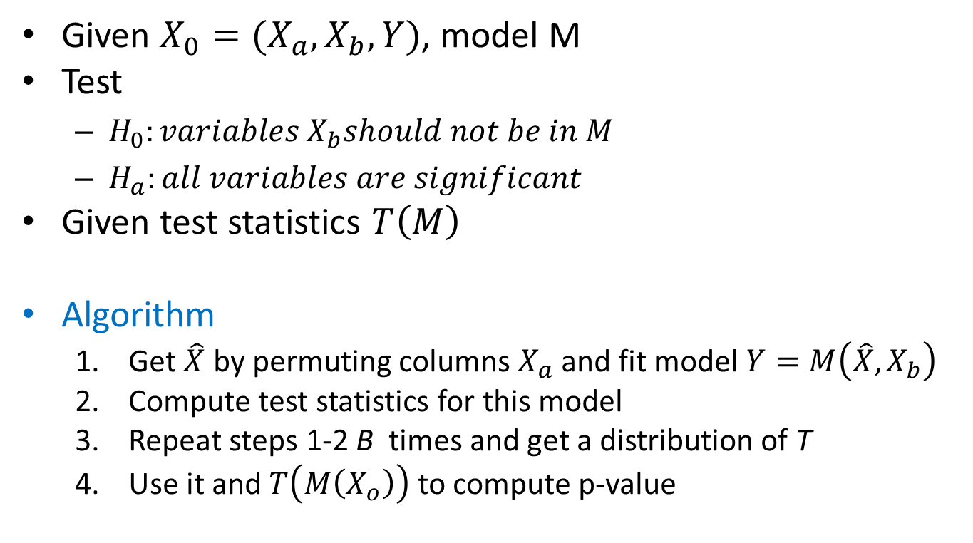
Permutation tests for model selection
Given $X_{0}=(X_{a}, X_{b}, Y)$, model M
Test
$H_{0}:variables X_{b}should not be in M$
$H_{a}:all variables are significant$
Given test statistics $T\left(M\right)$
Algorithm
Get $\hat{X}$ by permuting columns $X_{a}$ and fit model $Y=M\left(\hat{X},X_{b}\right)$
Compute test statistics for this model
Repeat steps 1-2 B times and get a distribution of T
Use it and $T\left(M\left(X_{o}\right)\right)$ to compute p-value

Slide 27

Bootstrap bias corrections
Theory shows
The last term is computed by
Using observation set D=(X₁,…X_{n}), sample with replacement and get bootstrap sample D₁ =(X*₁,…X*_{n}),
Repeat step 1 B times
Take the mean of T(D₁)… T(D_{B})
The first term is the 2T(D)

Slide 28

Bootstrap variance estimation
Using bootstrap, compute T^{*1}=T(D₁)… T^{*m}= T(D_{B})

Slide 29
Jackknife methods
Idea: similar to CV, but used in statistical inference
Bias estimation
Variance estimation
”Jackknife methods make use of systematic partitions of a dataset to estimate properties of an estimator computed from the full sample”
Suppose, we are given a random sample Y=(Y₁,…,Y_{n}) and some estimator T(Y)

Slide 30




Jackknife methods
First-order jackknife
Obtain Y_{(-j)} by dropping group of observations j from Y
For each j, compute T_{(-j)} =T(Y_{(-j)} )
Compute pseudovalues and J(T), called jackknifed T:
Equivalently,

Slide 31


Jackknife variance estimate
We can use T_{(-j)} or pseudovalues as estimates of T for different samples (both give equivalent expression).
Variance becomes
Sometimes, one takes
!The variance is often overestimated

Slide 32

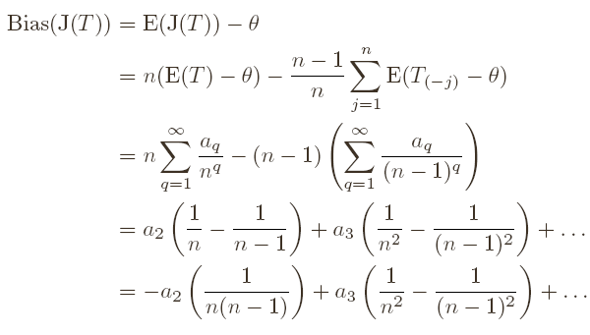
Jackknife bias correction
First-order jackknife
The bias reduced to order n⁻¹ (we take r=n)

Slide 33


Jackknife estimation of bias
We see that
Hence, bias is

Slide 34


Higher-order jackknife
The order of the bias can be further reduced
Second-order jackknife
Higer order jackkifes –combining jackknifes of lower orders:

Slide 35
Higher-order jackknife
Comments
High order jackknifes reduce the bias but they increase the variance
Delete-1 jackknife is not always appropriate (median). Use delete-k

